Slide 1
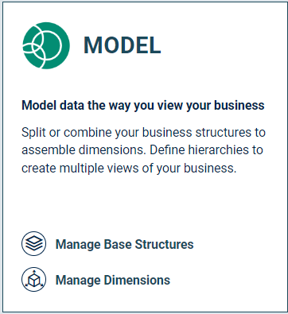
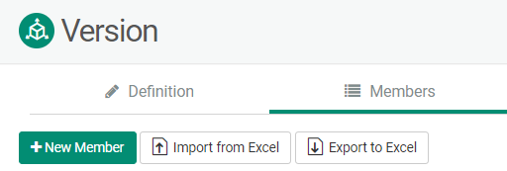
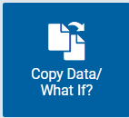
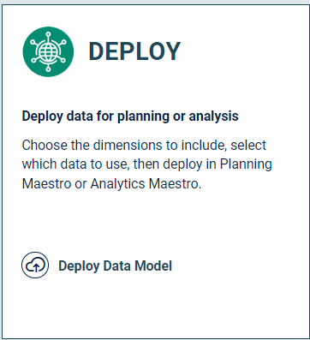
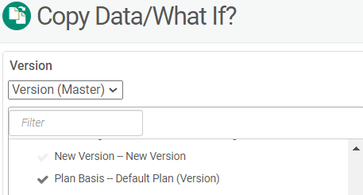
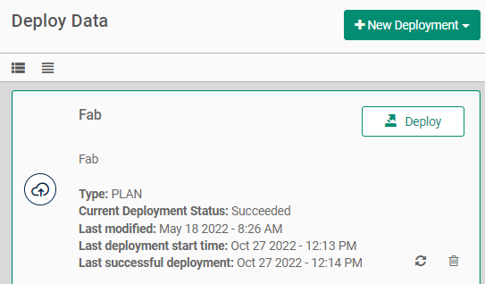
How to Create a New Version
Data Modeler
Manage Dimensions
Version Dimension
+ New Member
Deploy Data Model
Financial Intelligence Set-up
Copy Data/What if?
Choose the Source Version
Choose the Destination Version
Add to Preview
Copy Data/What if?

